Slide 1
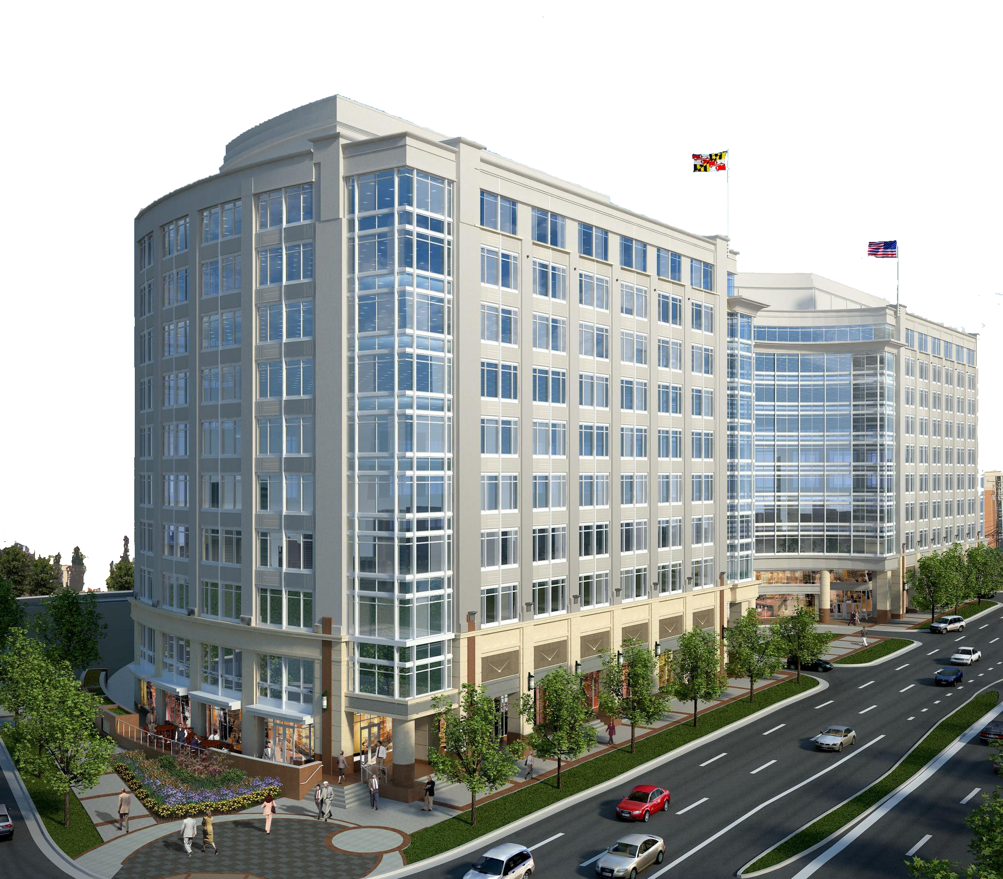
Rockville Metro Plaza II
Rockville Pike
John Vais | Structural Option
Rockville, Maryland
PSU AE Senior Thesis 2014
Faculty Advisor – Dr. Hanagan
www.klnbretail.propertycapsule.com

Slide 2
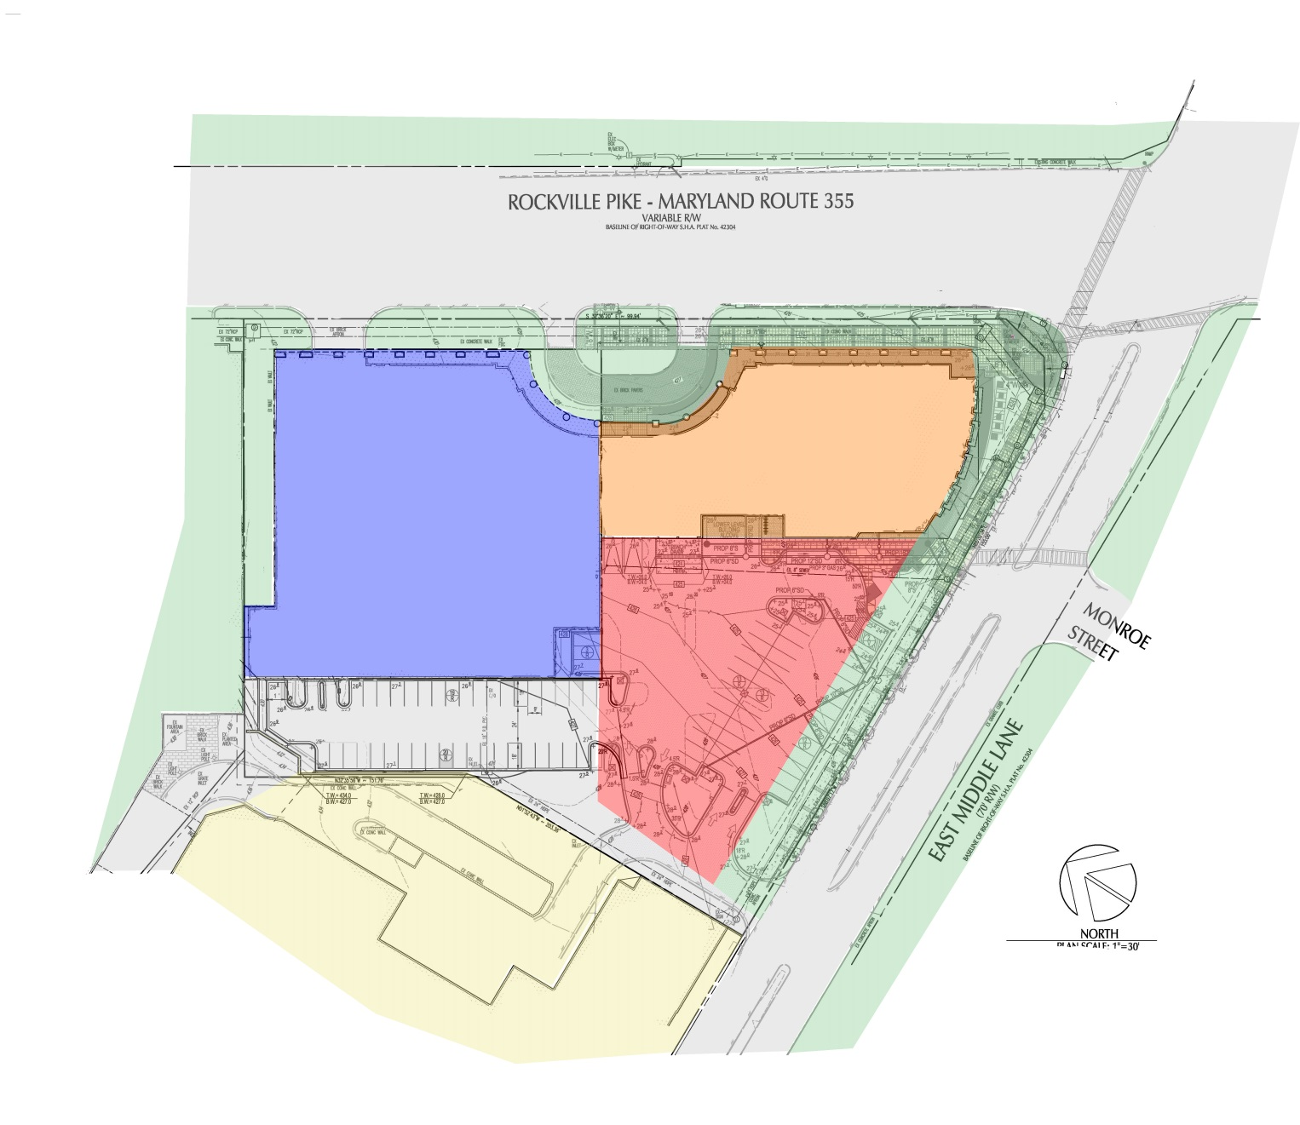
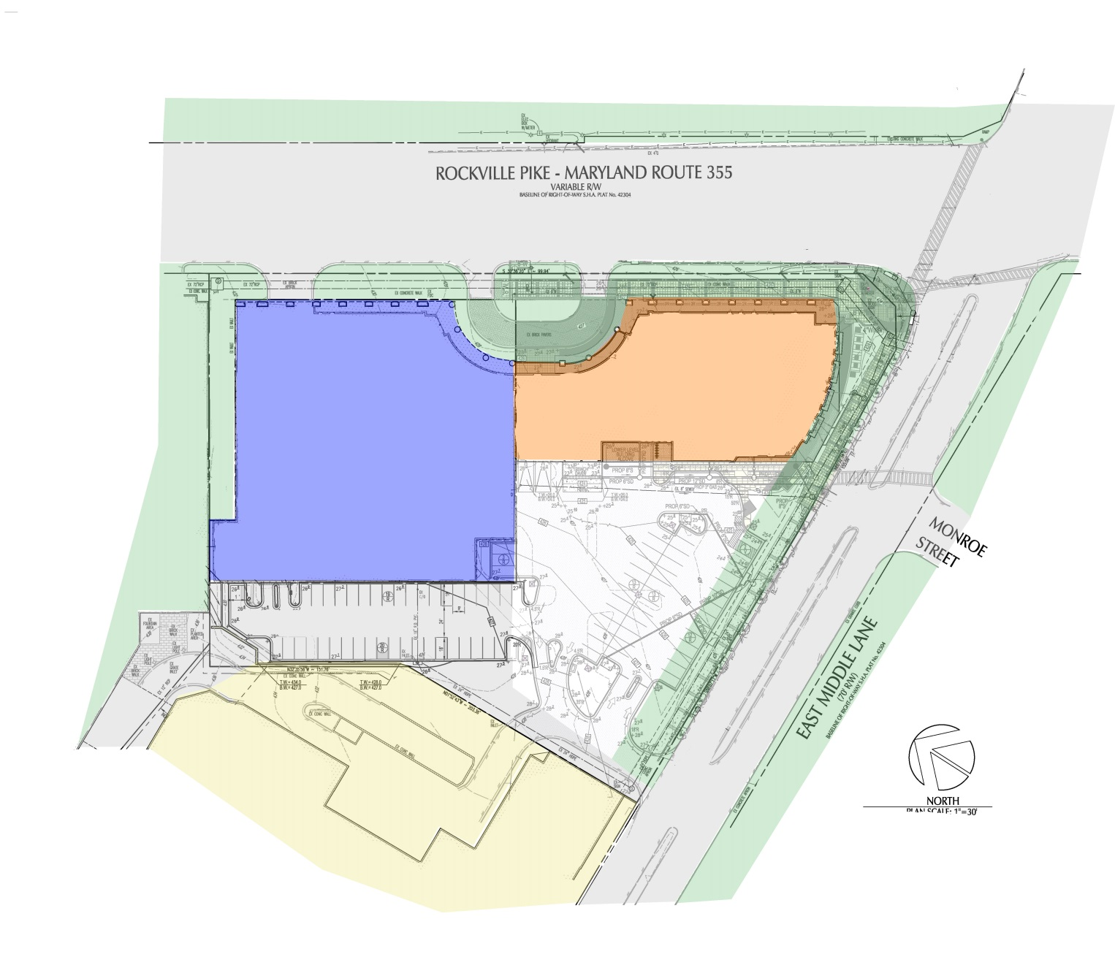
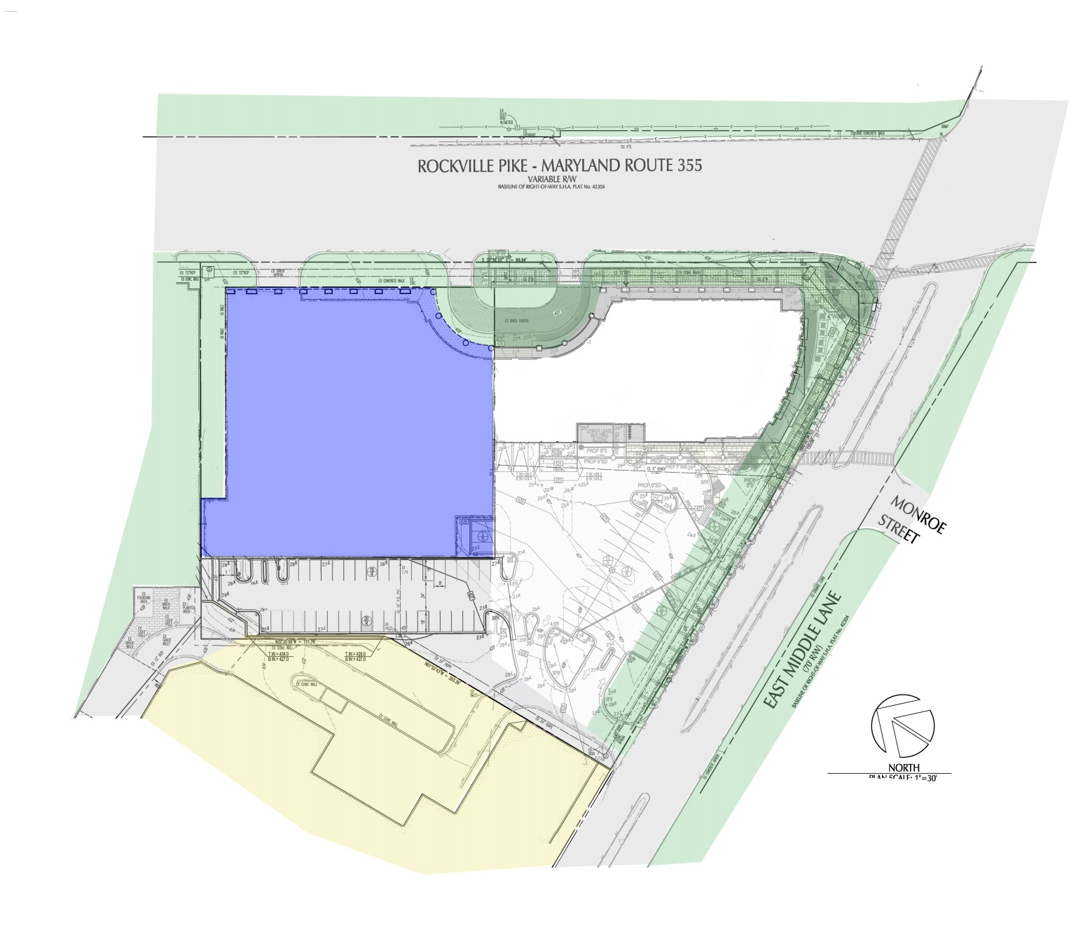
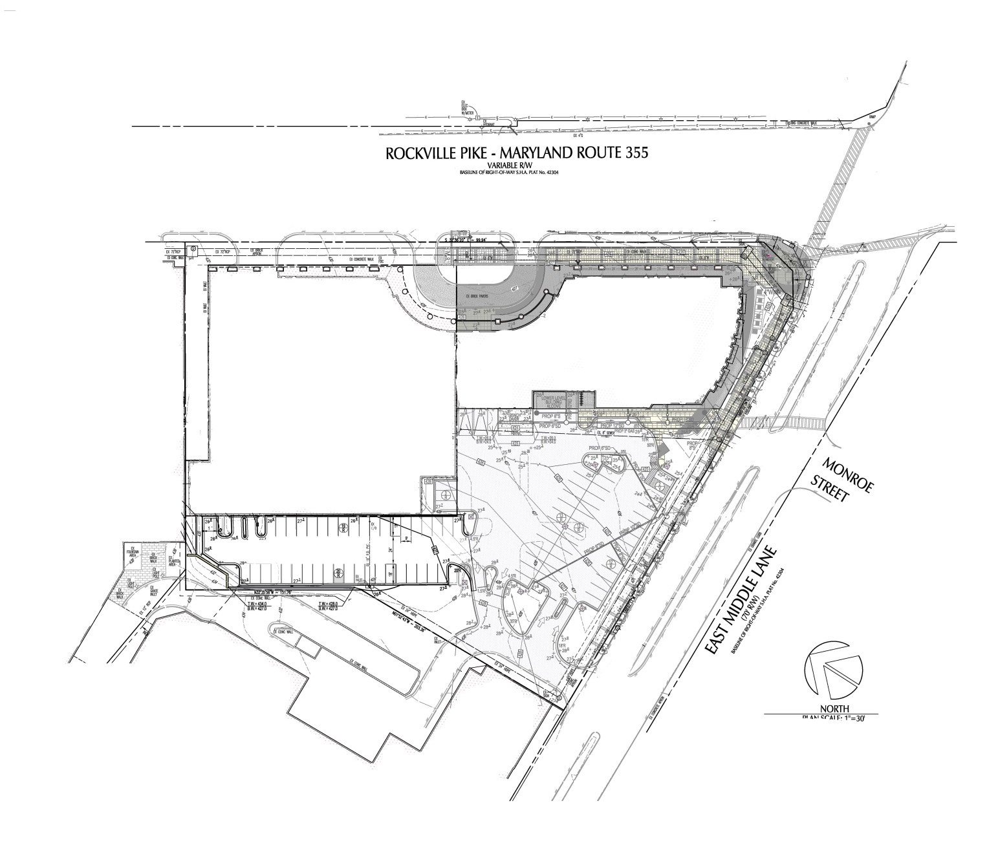
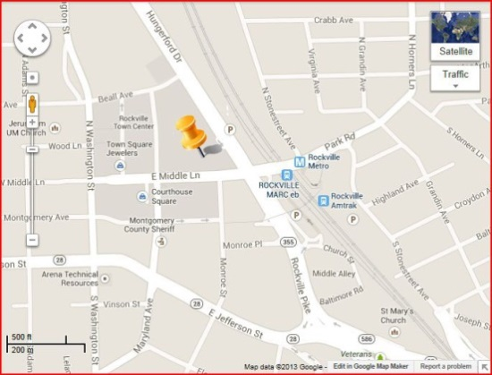
Rockville Metro Plaza II
Introduction
Developer – Foulger-Pratt
Architect – WDG Architecture
Structural Engineer– Cagley and Associates
Building Introduction
Existing Structural System
Problem Statement
Proposed Solution
Gravity Redesign
Lateral Redesign
Architectural Study
Construction Study
Conclusion
Acknowledgments
Questions/Comments
Phase II
Phase I
323,000 GSF
Completed – Fall 2013
10 Stories Above Grade (Office)
  3 Below Grade (Parking)
Retail Space on Plaza Level
Prominent Location
LEED Platinum
Phase III

Slide 3
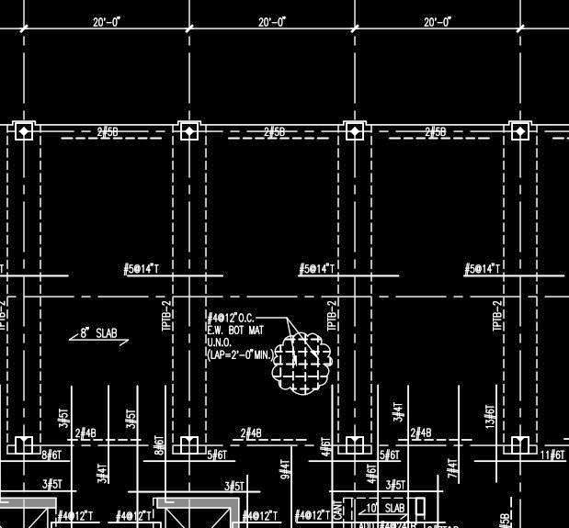
Rockville Metro Plaza II
Existing Gravity System
Building Introduction
Existing Structural System
Problem Statement
Proposed Solution
Gravity Redesign
Lateral Redesign
Architectural Study
Construction Study
Conclusion
Acknowledgments
Questions/Comments
One-way concrete slabs
  Bay – 20’ x 40’ (typically)
Post tensioned beams – 20” x 48”
Cast in place columns – 2’ x 2’
Open/versatile floor plan

Slide 4
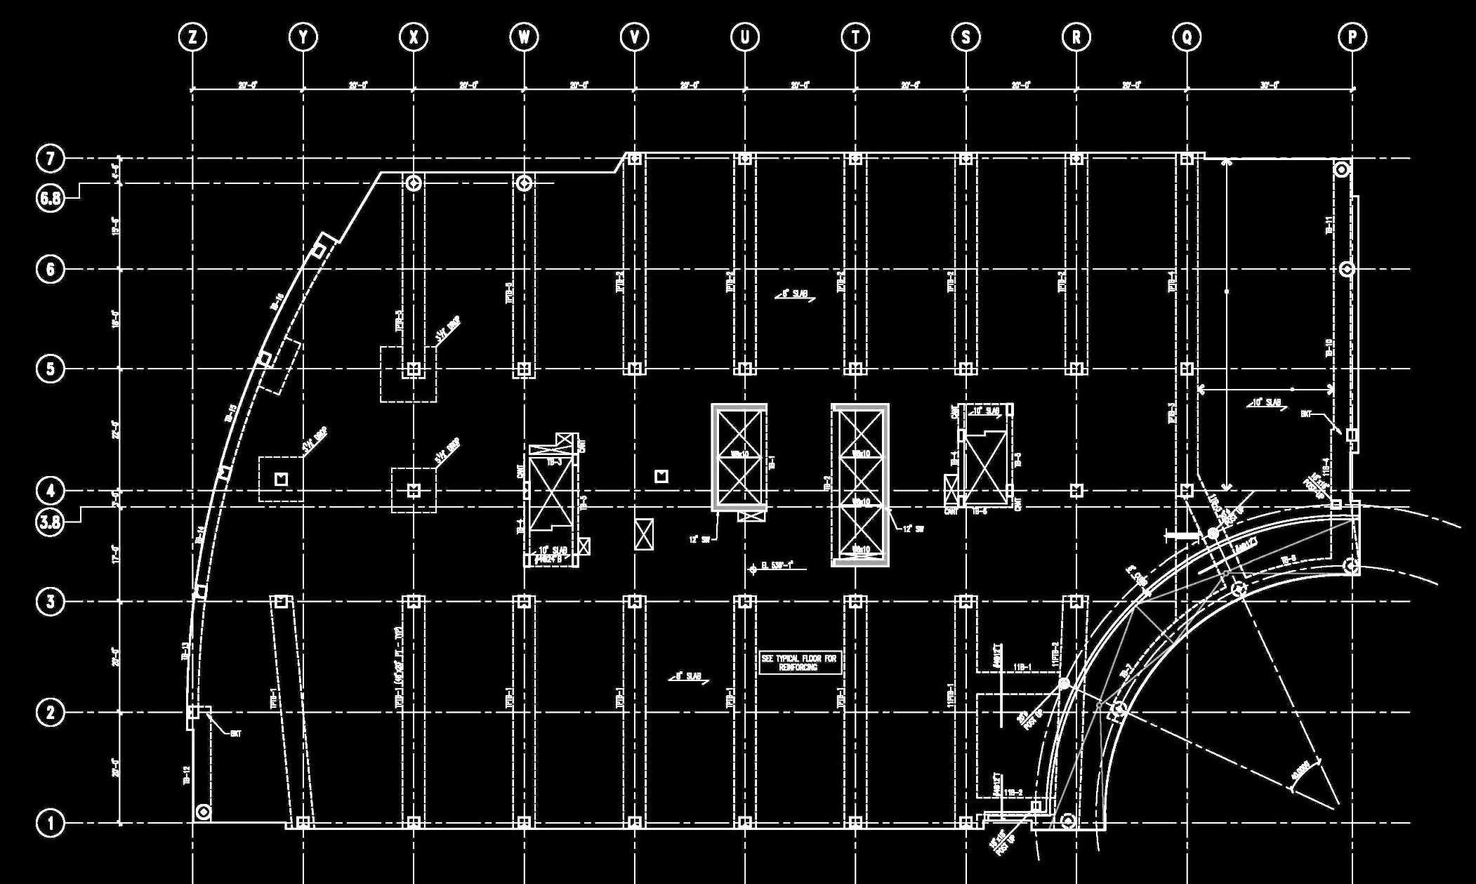
Rockville Metro Plaza II
Existing Lateral System
Building Introduction
Existing Structural System
Problem Statement
Proposed Solution
Gravity Redesign
Lateral Redesign
Architectural Study
Construction Study
Conclusion
Acknowledgments
Questions/Comments
Concrete shear walls at elevator core
  12 inch thick
Concrete moment frames
Low impact on architecture

Slide 5
Rockville Metro Plaza II
Problem Statement
Building Introduction
Existing Structural System
Problem Statement
Proposed Solution
Gravity Redesign
Lateral Redesign
Architectural Study
Construction Study
Conclusion
Acknowledgments
Questions/Comments
Concrete structure results in a large building self weight
Lengthy schedule duration due to concrete construction
Concrete labor intensive

Slide 6
Rockville Metro Plaza II
Proposed Solution
Goals
Building Introduction
Existing Structural System
Problem Statement
Proposed Solution
Gravity Redesign
Lateral Redesign
Architectural Study
Construction Study
Conclusion
Acknowledgments
Questions/Comments
Employ steel structure
  Investigate self weight reduction
  Investigate use of composite beams and LW concrete
Maintain architectural design intentions
  Open floor plan
  Ceiling height/ceiling cavity
Decrease cost and construction duration
Reduce building weight
Maintain architectural intentions
Reduce overall cost
Reduce schedule duration

Slide 7
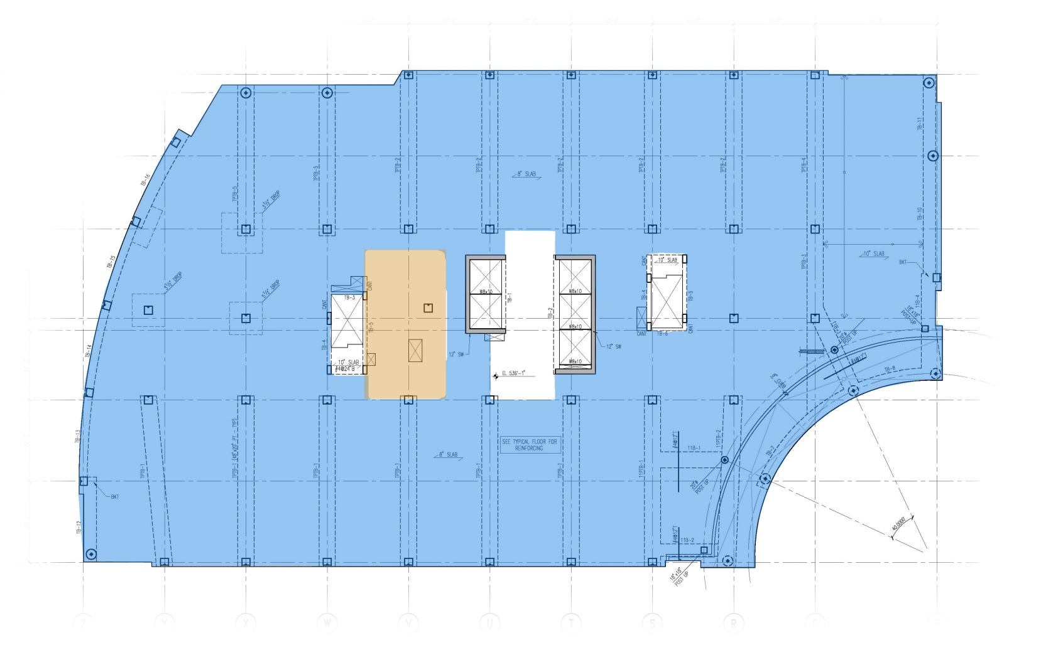
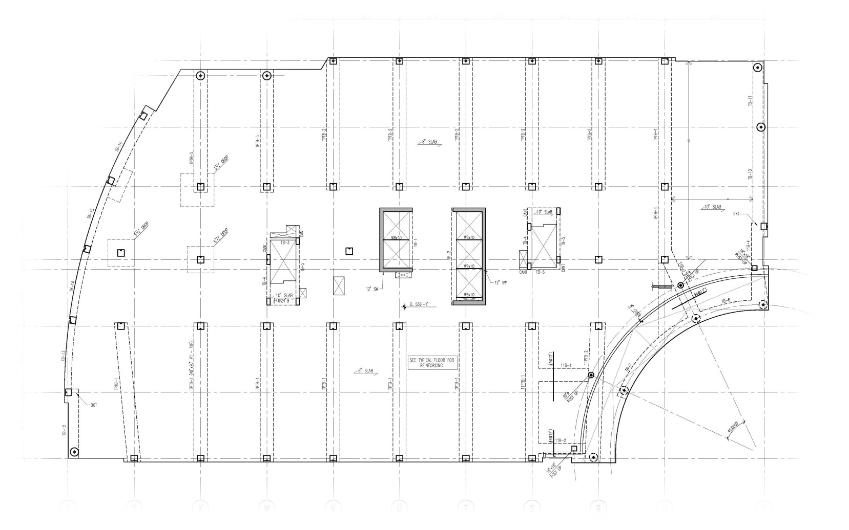
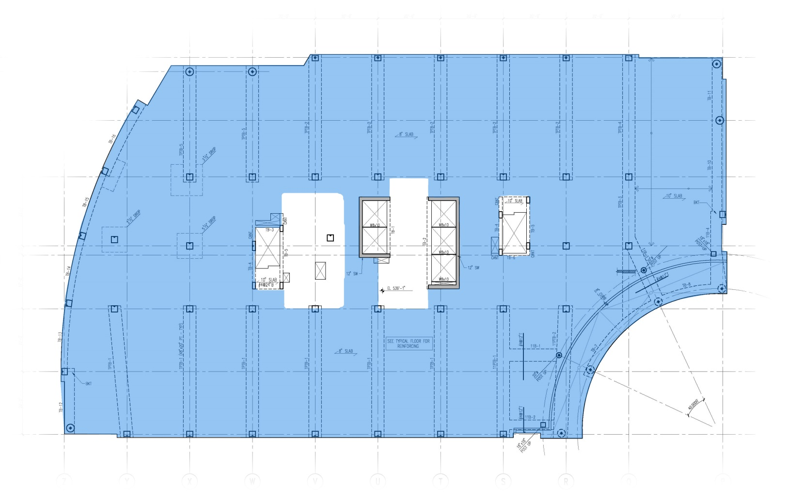
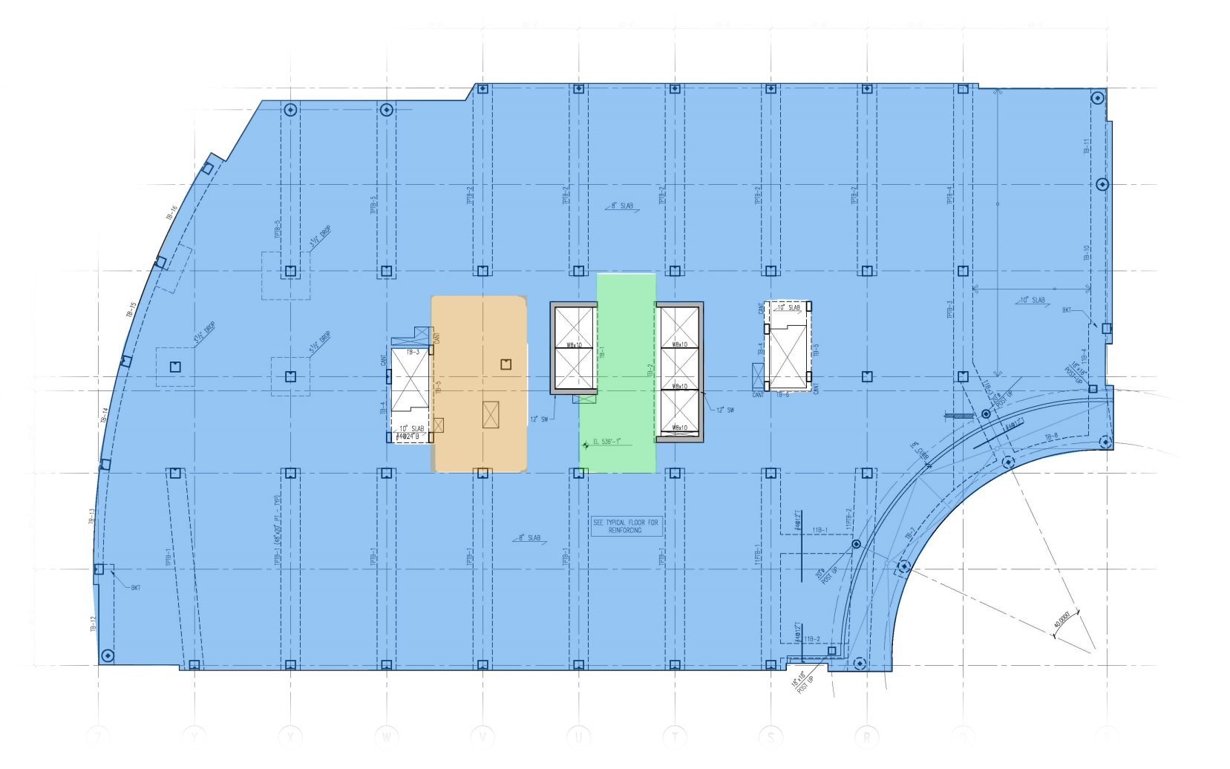
Rockville Metro Plaza II
Gravity Design
Gravity Loads
Building Introduction
Existing Structural System
Problem Statement
Proposed Solution
Gravity Redesign
Lateral Redesign
Architectural Study
Construction Study
Conclusion
Acknowledgments
Questions/Comments
  Floor Loads
    Live Load – 80 psf
    Partitions – 20 psf
    Superimposed DL – 5 psf
  Mechanical Rooms
    Live Load – 150 psf*
  Corridors (above first)
    Live Load – 100 psf

Slide 8
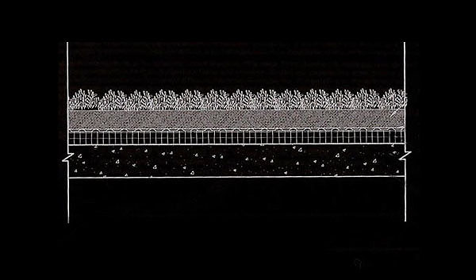
Rockville Metro Plaza II
Gravity Design
Floor Live Loads
Area | As Designed (psf) | ASCE 7-05 (psf)
Corridors (first level) | 100 | 100
Corridors (above first) | 100 | 80
Lobbies | 100 | 100
Marquees/Canopies | 75 | 75
Mechanical Room | 150 (U) | 125
Offices | 80 + 20 (partitions) | 50 + 20 (partitions)
Parking Garage | 50 | 40
Retail – First Floor | 100 | 100
Stairs/Exit Ways | 100 (U) | 100
Storage (Light) | 125 (U) | 125
Gravity Loads
Building Introduction
Existing Structural System
Problem Statement
Proposed Solution
Gravity Redesign
Lateral Redesign
Architectural Study
Construction Study
Conclusion
Acknowledgments
Questions/Comments
  Roof Loads
    Live Load – 20 psf
    Snow – 17.5 psf
    Green Roof – 40 psf
    Superimposed DL – 10 psf

Slide 9
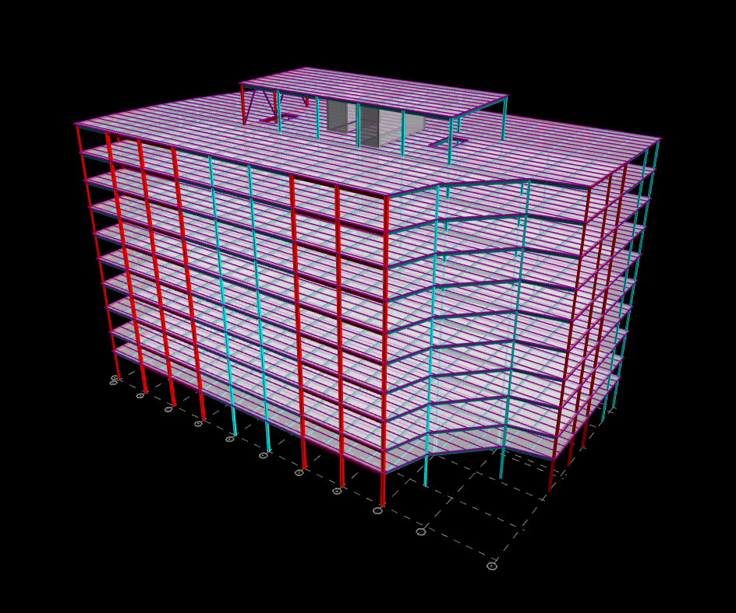
Rockville Metro Plaza II
Gravity Design
Building Introduction
Existing Structural System
Problem Statement
Proposed Solution
Gravity Redesign
Lateral Redesign
Architectural Study
Construction Study
Conclusion
Acknowledgments
Questions/Comments
3.25” Lightweight Concrete slab
  2”, 20 gage metal decking
Beam spacing – 10’ max
  Unshored
  Long span direction
Columns spliced every two levels

Slide 10
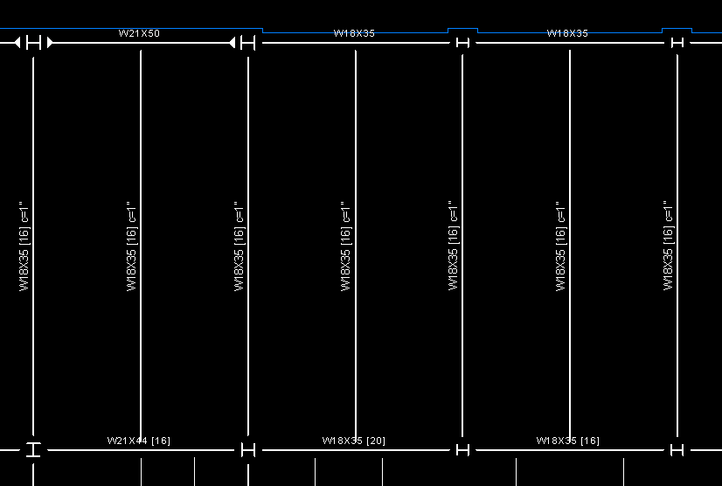
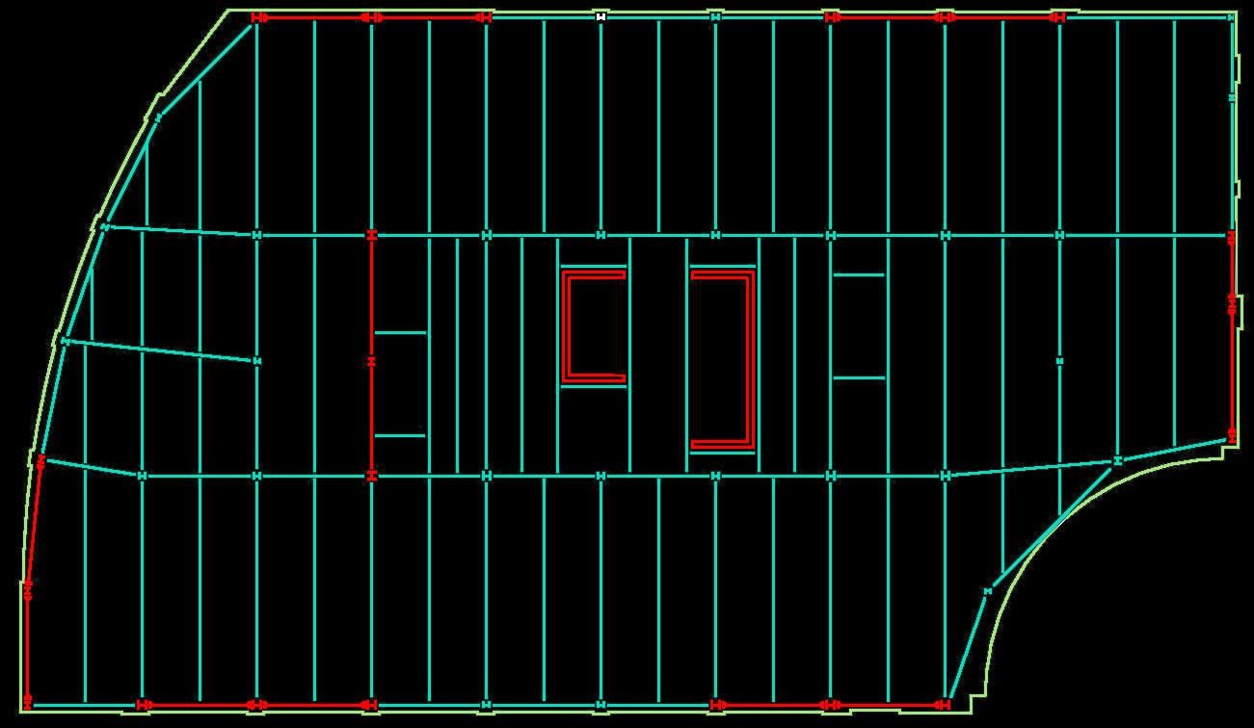
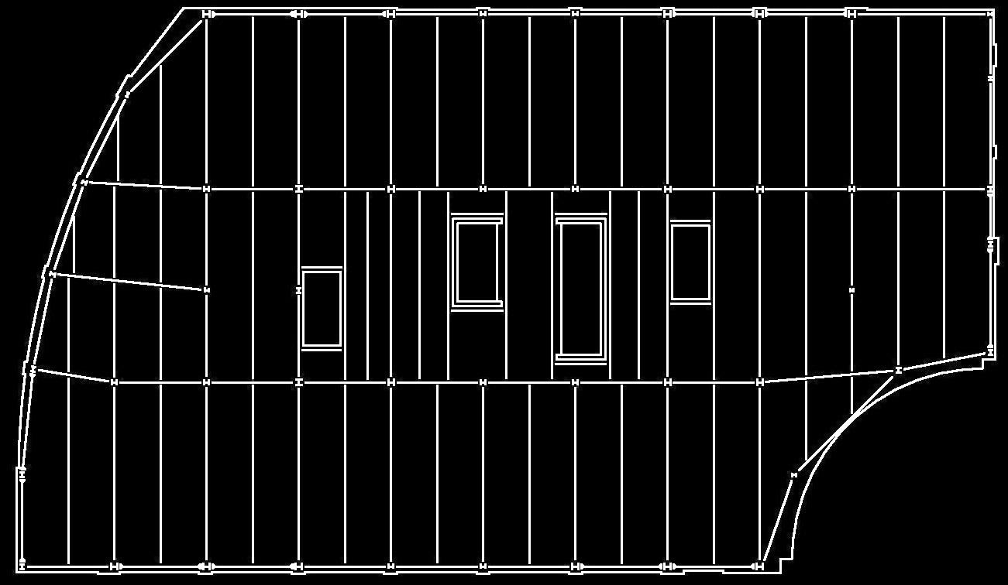
Rockville Metro Plaza II
Gravity Design
Building Introduction
Existing Structural System
Problem Statement
Proposed Solution
Gravity Redesign
Lateral Redesign
Architectural Study
Construction Study
Conclusion
Acknowledgments
Questions/Comments
Typical Sizes – W18x--
Floor depth
  Increased Overall
Retain original column location
  Coordinating varying levels

Slide 11
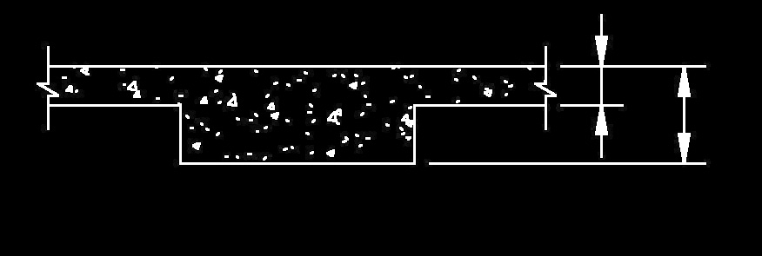
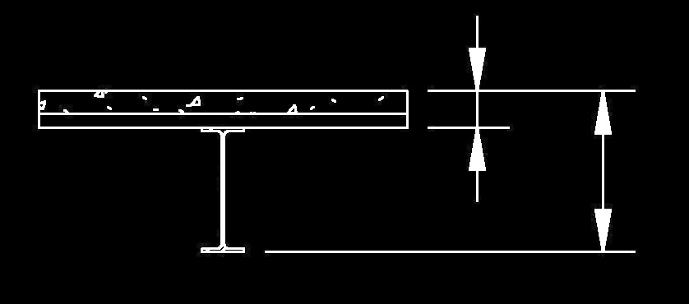
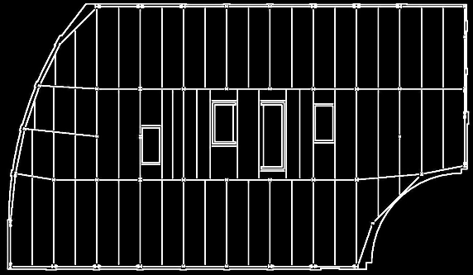
Rockville Metro Plaza II
Gravity Design
Floor Depth
8”
20”
Building Introduction
Existing Structural System
Problem Statement
Proposed Solution
Gravity Redesign
Lateral Redesign
Architectural Study
Construction Study
Conclusion
Acknowledgments
Questions/Comments
Retain ceiling heights
MEP space considerations
5.25”
23.25”

Slide 12
Rockville Metro Plaza II
Gravity Design
Floor Depth
Building Introduction
Existing Structural System
Problem Statement
Proposed Solution
Gravity Redesign
Lateral Redesign
Architectural Study
Construction Study
Conclusion
Acknowledgments
Questions/Comments
Retain ceiling heights
MEP space considerations
Increase floor depth on each level
  Approximately 8’ added to building height
  Exceeds zoning

Slide 13
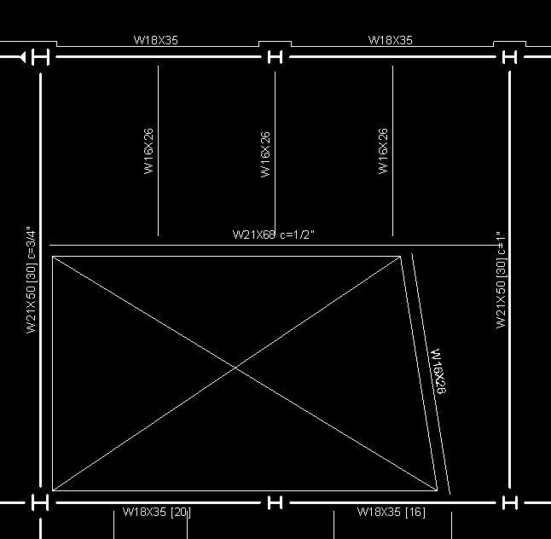
Rockville Metro Plaza II
Gravity Design
Floor Opening
Building Introduction
Existing Structural System
Problem Statement
Proposed Solution
Gravity Redesign
Lateral Redesign
Architectural Study
Construction Study
Conclusion
Acknowledgments
Questions/Comments
Produces exciting lobby space
Connects levels more intimately
Creates sitting room mezzanine
Adds to the open feel of the space

Slide 14
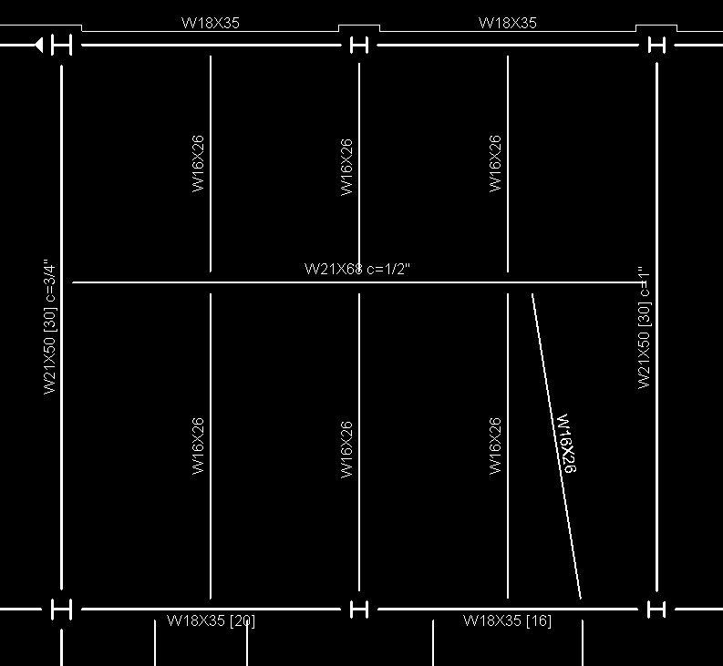
Rockville Metro Plaza II
Gravity Design
Floor Opening
Building Introduction
Existing Structural System
Problem Statement
Proposed Solution
Gravity Redesign
Lateral Redesign
Architectural Study
Construction Study
Conclusion
Acknowledgments
Questions/Comments
Design as option
  Open Section
  Infill Area
Design for each scenario
  Beam Design
  Column Design

Slide 15
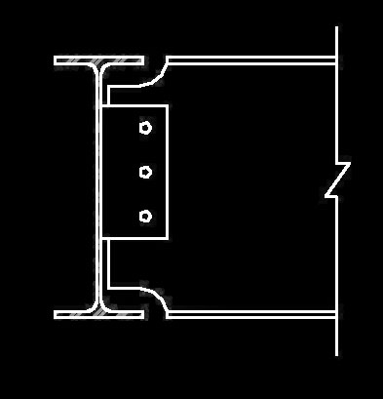
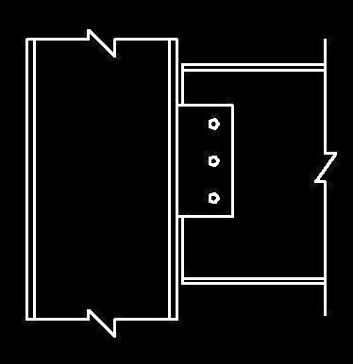
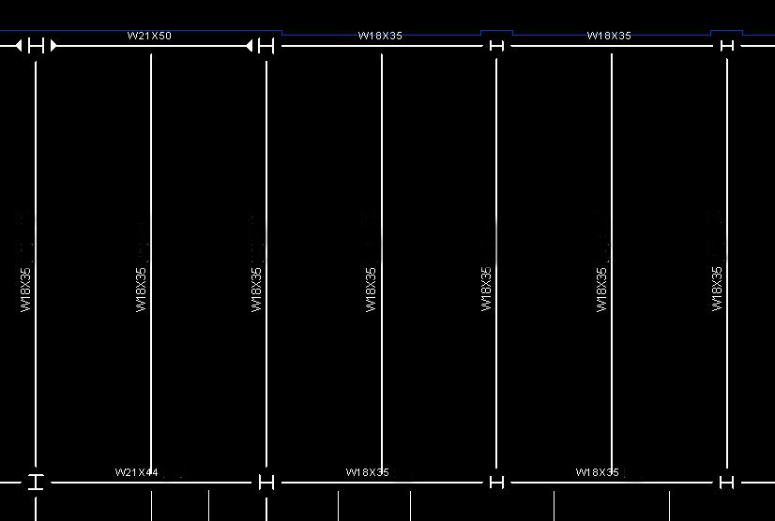
Rockville Metro Plaza II
Gravity Design
Connections
Building Introduction
Existing Structural System
Problem Statement
Proposed Solution
Gravity Redesign
Lateral Redesign
Architectural Study
Construction Study
Conclusion
Acknowledgments
Questions/Comments
Beam-to-Girder
Shear Tab
Beam-to-Column
Shear Tab

Slide 16
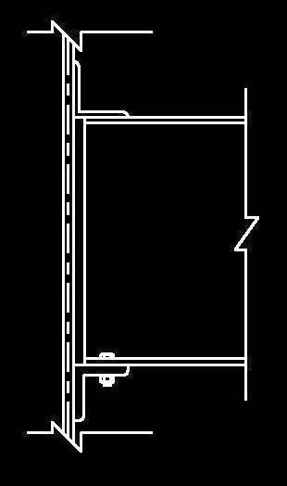
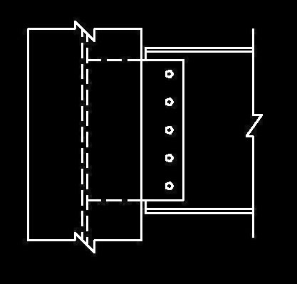
Rockville Metro Plaza II
Gravity Design
Connections
Building Introduction
Existing Structural System
Problem Statement
Proposed Solution
Gravity Redesign
Lateral Redesign
Architectural Study
Construction Study
Conclusion
Acknowledgments
Questions/Comments
Beam-to-Column
Extended Shear Tab
(Upper Level)
Beam-to-Column
Unstiffened Seat
(Lower Levels)

Slide 17
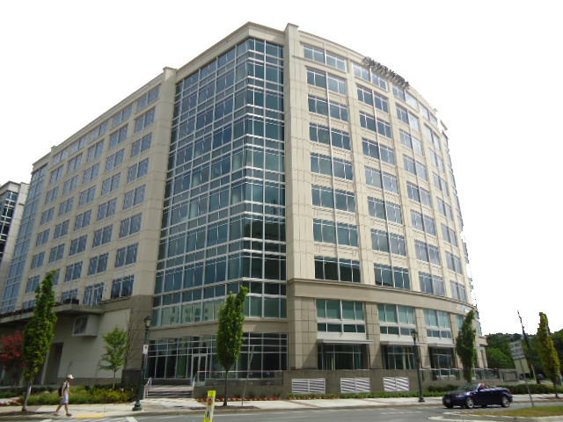
Rockville Metro Plaza II
Lateral Design
Building Introduction
Existing Structural System
Problem Statement
Proposed Solution
Gravity Redesign
Lateral Redesign
Architectural Study
Construction Study
Conclusion
Acknowledgments
Questions/Comments
Wind – Method 2 of ASCE 7 (Chapter 6)
Seismic – ELFP of ASCE 7 (Chapter 11)
  Seismic design category
  Seismic base taken at plaza level
Wind controlled both strength and serviceability

Slide 18
Rockville Metro Plaza II
Lateral Design
Load Comparison
Building Introduction
Existing Structural System
Problem Statement
Proposed Solution
Gravity Redesign
Lateral Redesign
Architectural Study
Construction Study
Conclusion
Acknowledgments
Questions/Comments
Base Shear (kips)
 | Concrete | Steel
Wind N-S | 247 | 265
Wind E-W | 497 | 536
Seismic N-S | 643 | 442
Seismic E-W | 643 | 479
Building height increased
  Wind loads increased
Building weight reduced
  Seismic loads decreased
Wind controls

Slide 19
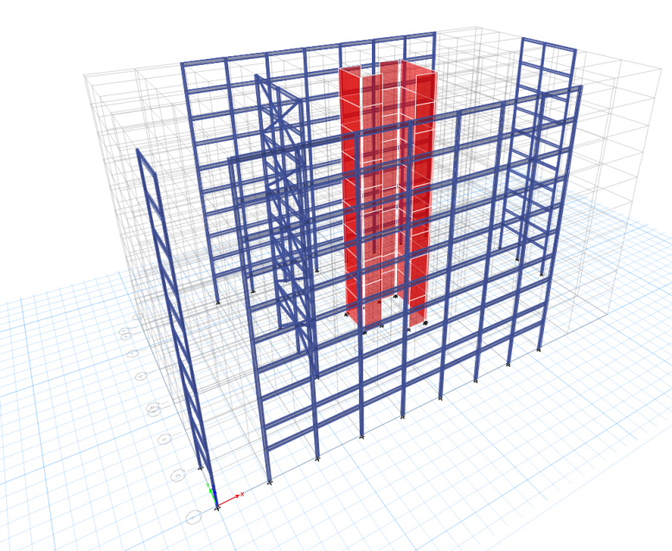
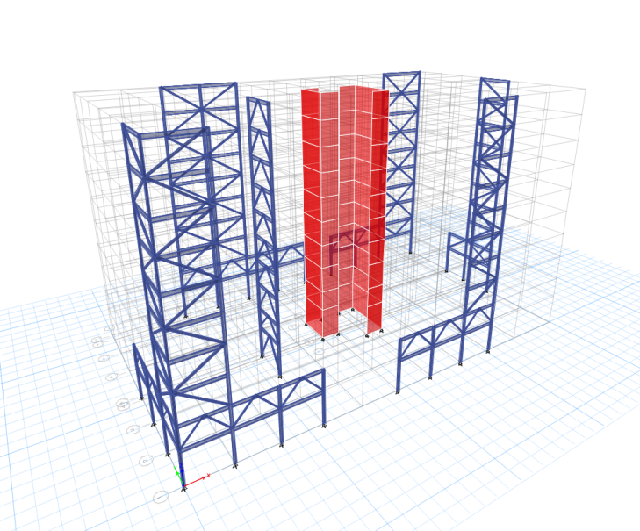
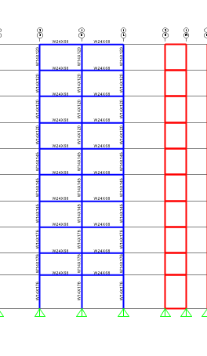
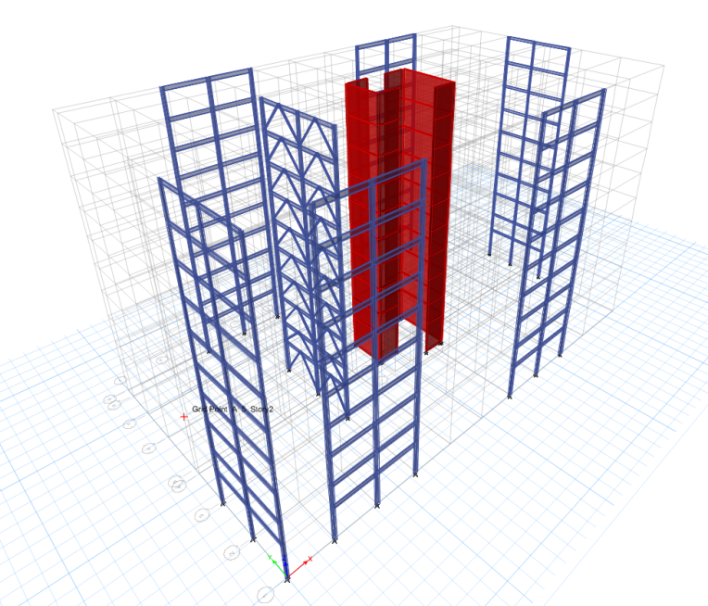
Rockville Metro Plaza II
Lateral Design
Building Introduction
Existing Structural System
Problem Statement
Proposed Solution
Gravity Redesign
Lateral Redesign
Architectural Study
Construction Study
Conclusion
Acknowledgments
Questions/Comments
Architectural study
  Eliminated exterior braced frames
Structural investigation
  Isolate lateral system
  Determine efficient design

Slide 20
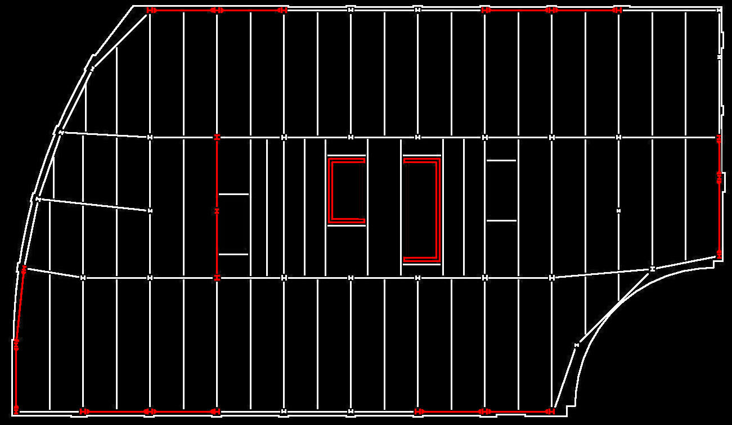
Rockville Metro Plaza II
Lateral Design
Building Introduction
Existing Structural System
Problem Statement
Proposed Solution
Gravity Redesign
Lateral Redesign
Architectural Study
Construction Study
Conclusion
Acknowledgments
Questions/Comments
Concrete core shear walls
  Architectural concerns
Perimeter steel moment frames
  Retain open floor plan/exterior views
Concentrically braced frame
  Realign center of rigidity

Slide 21
Rockville Metro Plaza II
Lateral Design
CM
CR
Building Introduction
Existing Structural System
Problem Statement
Proposed Solution
Gravity Redesign
Lateral Redesign
Architectural Study
Construction Study
Conclusion
Acknowledgments
Questions/Comments
Concrete core shear walls
  Architectural concerns
Perimeter steel moment frames
  Retain open floor plan/exterior views
Concentrically braced frame
  Realign center of rigidity
Original ecc. = 17.5’
Redesigned ecc. = 3.5’

Slide 22
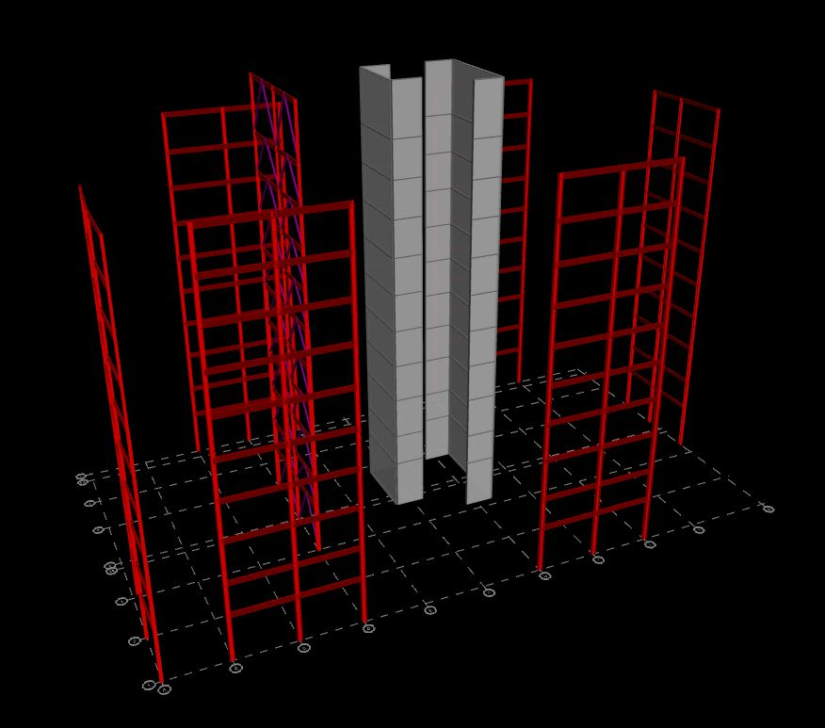
Rockville Metro Plaza II
Lateral Design
Building Introduction
Existing Structural System
Problem Statement
Proposed Solution
Gravity Redesign
Lateral Redesign
Architectural Study
Construction Study
Conclusion
Acknowledgments
Questions/Comments
Concrete core shear walls
  Architectural concerns
Perimeter steel moment frames
  Retain open floor plan/exterior views
Concentrically braced frame
  Realign center of rigidity

Slide 23
Rockville Metro Plaza II
Lateral Design
Building Introduction
Existing Structural System
Problem Statement
Proposed Solution
Gravity Redesign
Lateral Redesign
Architectural Study
Construction Study
Conclusion
Acknowledgments
Questions/Comments
Rigid diaphragm assumption
Walls neglect out of plane stiffness
Concrete stiffness modifies as per ACI 318-11
P-Delta Checks
Drift Checks

Slide 24
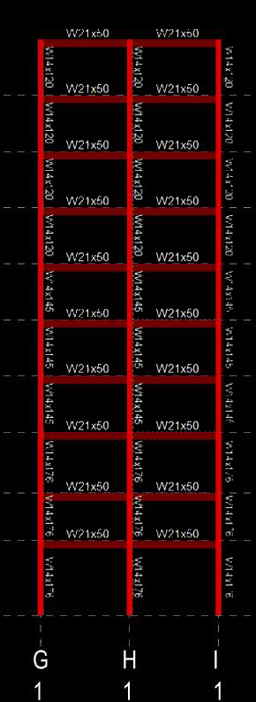
Rockville Metro Plaza II
Lateral Design
Moment Frame
Building Introduction
Existing Structural System
Problem Statement
Proposed Solution
Gravity Redesign
Lateral Redesign
Architectural Study
Construction Study
Conclusion
Acknowledgments
Questions/Comments
Strong column – Weak beam
Serviceability controls design
  Wind drifts
Perimeter frames
  Further mitigate torsion effects

Slide 25
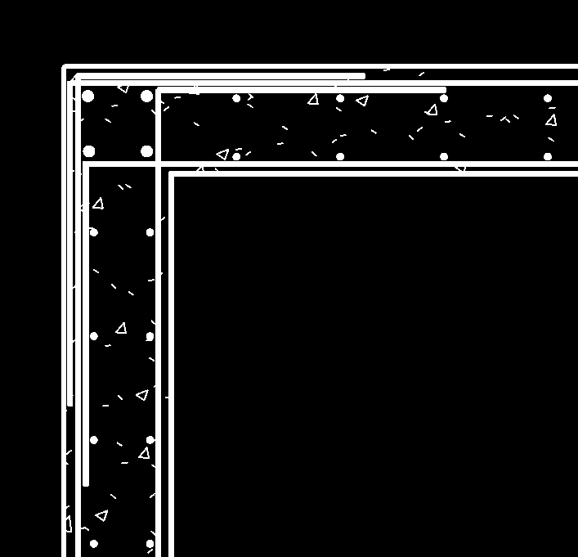
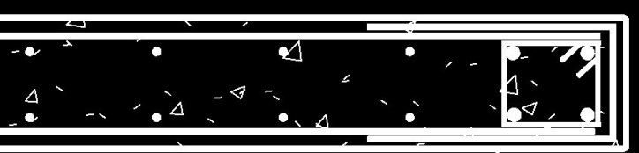
Rockville Metro Plaza II
Lateral Design
Shear Walls
Building Introduction
Existing Structural System
Problem Statement
Proposed Solution
Gravity Redesign
Lateral Redesign
Architectural Study
Construction Study
Conclusion
Acknowledgments
Questions/Comments
Controlling load combination
  0.9D + 1.6W
Wall Thickness – 12”
#4 @ 12” o.c. EW
Boundary reinforcing for flexure

Slide 26
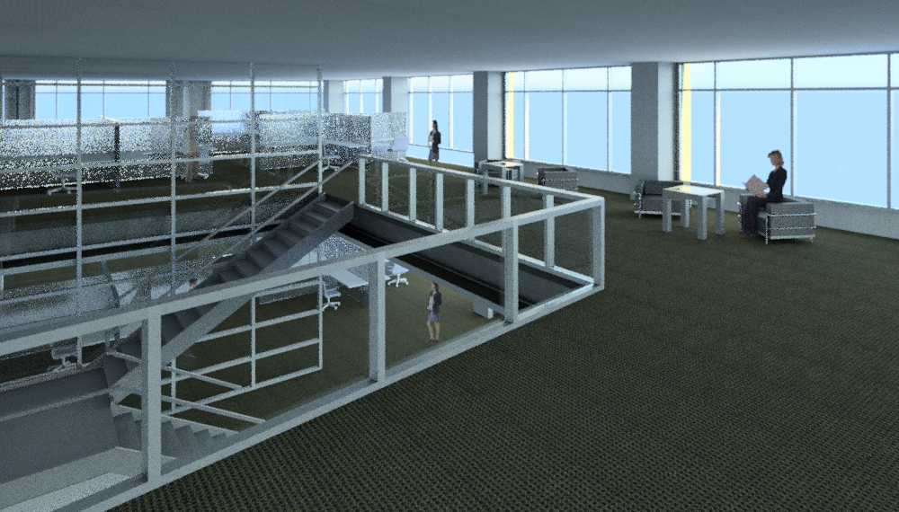
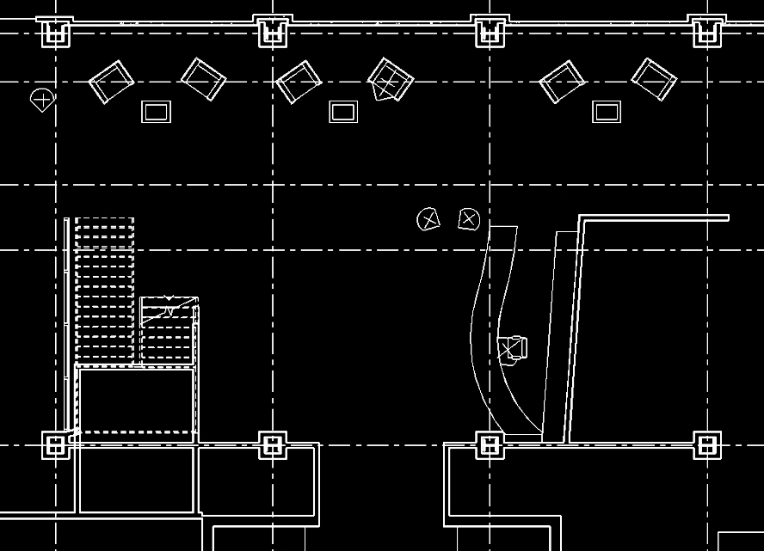
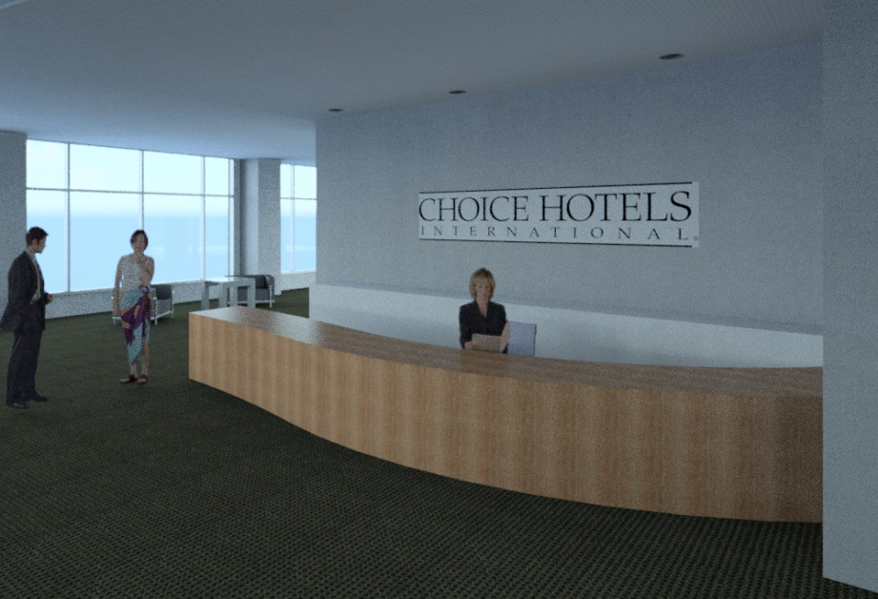
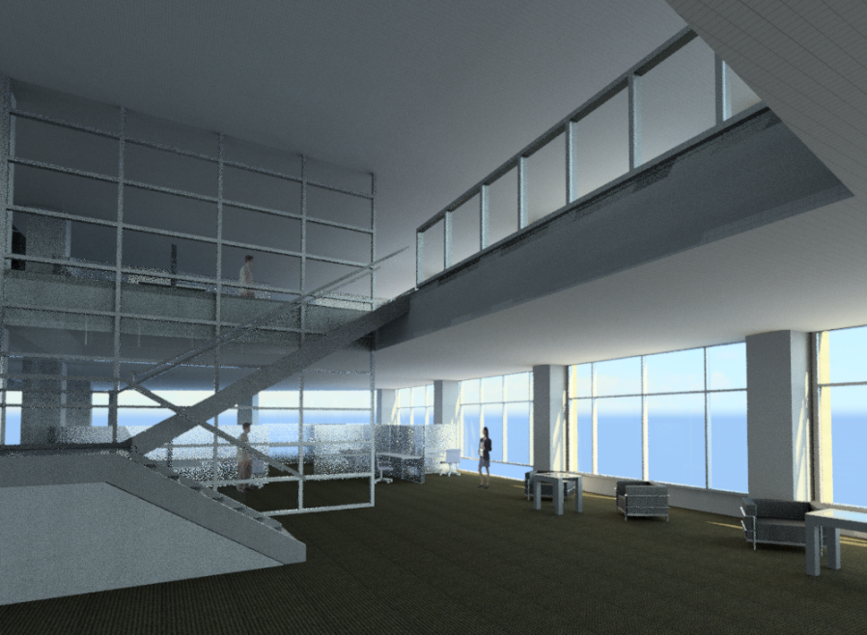
Rockville Metro Plaza II
Architectural Study
Building Introduction
Existing Structural System
Problem Statement
Proposed Solution
Gravity Redesign
Lateral Redesign
Architectural Study
Construction Study
Conclusion
Acknowledgments
Questions/Comments
Produces exciting lobby space
Connects levels more intimately
Creates sitting room mezzanine
Adds to the open feel of the space

Slide 27
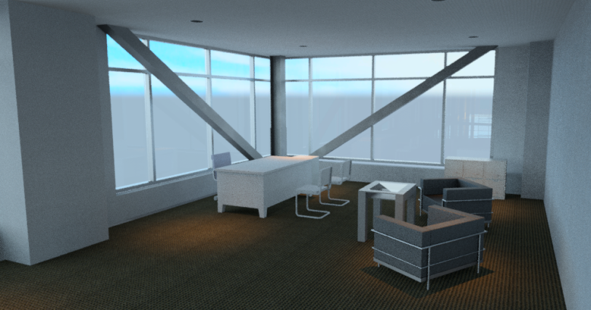
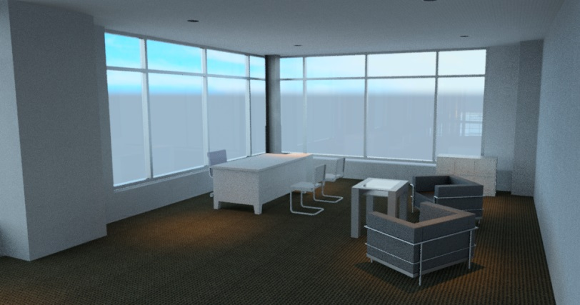
Rockville Metro Plaza II
Architectural Study
Exterior Braced Frames
  Obstruct exterior views
  Obstruct building entrances
  More expensive façade
    (if built integrally)
Interior braced frames
  No walls for placement
  Hinder flow of open floor plan
Conclusion to employ moment frames
Building Introduction
Existing Structural System
Problem Statement
Proposed Solution
Gravity Redesign
Lateral Redesign
Architectural Study
Construction Study
Conclusion
Acknowledgments
Questions/Comments

Slide 28
Rockville Metro Plaza II
Construction Study
Steel Option Summary
 | Tot. Incl O&P
Steel Deck | $736,339
Welded Wire Fabric | $126,631
Placing Concrete | $107,610
Finishing Concrete | $225,122
Concrete Topping | $724,614
Steel Beams | $2,379,232
Steel Columns | $1,133,117
Shear Studs | $41,754
Fireproofing Beams | $267,472
Fireproofing Columns | $138,234
Total | $5,880,130
Building Introduction
Existing Structural System
Problem Statement
Proposed Solution
Gravity Redesign
Lateral Redesign
Architectural Study
Construction Study
Conclusion
Acknowledgments
Questions/Comments
Detailed estimate calculated for each system
Cost of structure reduced by 5%
Predicted schedule reduction of 11 months
Concrete Option Summary
 | Tot. Incl O&P
Concrete Formwork | $3,237,060
Structural Concrete | $985,143
Placing Concrete | $470,352
Finishing Concrete | $306,404
Reinforcing | $1,226,880
Total | $6,225,841
$26.55 per sf
$25.07 per sf

Slide 29
Rockville Metro Plaza II
Conclusion
Building Introduction
Existing Structural System
Problem Statement
Proposed Solution
Gravity Redesign
Lateral Redesign
Architectural Study
Construction Study
Conclusion
Acknowledgments
Questions/Comments
Design Viable Steel System
Maintain Architecture
Reduced Cost
Shorten Schedule
Increased Building Height
  Over Zoning
Further Coordination Required
  Architecture
  MEP

Slide 30


Rockville Metro Plaza II
Acknowledgements
Cagley and Associates
  Frank Malits
  Daniel Camp
Foulger-Pratt
AE Department
Family and Friends
Building Introduction
Existing Structural System
Problem Statement
Proposed Solution
Gravity Redesign
Lateral Redesign
Architectural Study
Construction Study
Conclusion
Acknowledgments
Questions/Comments

Slide 31
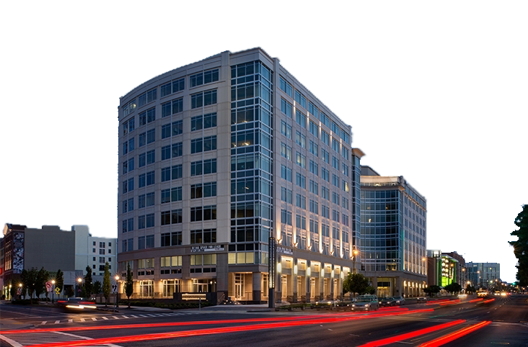
Rockville Metro Plaza II
Building Introduction
Existing Structural System
Problem Statement
Proposed Solution
Gravity Redesign
Lateral Redesign
Architectural Study
Construction Study
Conclusion
Acknowledgments
Questions/Comments
Questions/Comments
www.wdgarch.com

